Slide 1

TIPS AND GUIDELINES
FOR
PRESENTERS
Notes:
Notes

Slide 2
GUIDELINES FOR
PRESENTERS
Notes:
Notes

Slide 3
Each presenter will have a total of 10 minutes for their presentation, comprising both presentation time and Q&A (This is an update from the previous format, which allotted 7 minutes for presentation followed by a 3-minute Q&A for each presenter).
The Q&A session will now take place collectively for all presenters at the end of the session. A total of 20 minutes has been allocated for this Q&A session.
To upload your presentations please follow the below links:
For presenters: https://docs.google.com/forms/d/e/1FAIpQLSccFyl25P-rLbbnpITi6-7oda8YbRy-HVwF-pJVPaCNMW2nww/viewform?usp=publish-editor
If you have multiple abstract submissions, kindly fill out a separate form for each submission.
PRESENTATION GUIDELINES
Notes:
Notes

Slide 4
File Naming: Please name your file using the format: Track number_SubmissionID_Name of Presenting Author. For example: 1a_09_JamesSmith
Format: Submissions must be in PowerPoint format.
Font Size: For optimal readability, we recommend using a font size of at least 24 points for body text and 32 points for headings. Clear and legible fonts such as Arial, Calibri, or Helvetica are preferred.
Slide number: Include slide numbers for all slides.
SUBMISSION GUIDELINES
Notes:
Notes

Slide 5
Page Limit: Maximum of 12 pages, including the Title Page and Acknowledgement.
Page Breakdown:
Title Page: 1 page
Introduction: 2 pages
Objective: 1 page
Methodology: 2 pages
Results and Discussion: 4 pages
Implications and Future Research: 2 pages
Conclusion/Take Home Message: 1 page
Acknowledgement: 1 page
SUGGESTED PRESENTATION FORMAT
Notes:
Notes

Slide 6
TIPS AND GUIDELINES FOR
ONLINE PRESENTERS
Notes:
Notes

Slide 7
Incase of bad connectivity, during online presentation, we would like to request online presenters to also submit a video or audio recording of their presentation (10 min or less,)
This is to account for any internet contingencies during the conference sessions.
FOR ONLINE PRESENTERS
Notes:
Notes

Slide 8
Sit in a sound-absorbing environment, ideally with ample textiles to minimize echo and background noise.
Think about what your background looks like, try to make it calm.
Assess the lighting on your face; consider using an additional lamp to adjust/ enhance visibility.
Avoid filming against a window with bright light to prevent backlighting and glare.
Select a location where people won't be walking behind you within the camera frame to avoid distractions
Try sitting versus standing position for your presentation. Choose what feels most natural. (External webcam and microphone may be required if you want to stand.)
Think about what your outgoing image looks like and choose a reasonable distance to the camera.
1. PHYSICAL ENVIRONMENT
Notes:
Notes

Slide 9
Test your equipment, including your webcam, microphone, and lighting setup, prior to the presentation to address any technical issues in advance.
To optimize sound quality, consider using a headset or a table microphone and speakers
An external webcam may also be preferable on a laptop, for greater flexibility in adjusting your video image.
Prioritize a stable internet connection by using a fixed connection such as a network cable (Ethernet) instead of relying solely on WiFi.
2. DIGITAL ENVIRONMENT

Slide 10
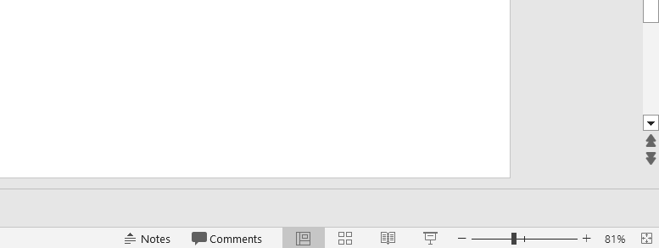
VERSION 1 (PRESENTATION SLIDES WITHOUT THE NOTES)
First, open the presentation file you intend to share during the Zoom meeting.
In Zoom, navigate to Share Screen and select the presentation file you want to share.
Apply the “Slide Show” mode located at the bottom right of the screen.
4. Your slides will now be visible to the audience.
3. SHARING POWERPOINT PRESENTATIONS ON ZOOM
Slide show
Notes:
Notes.

Slide 11
VERSION 2 (PRESENTATION SLIDES ALONG WITH THE NOTES)
First, open the presentation file you intend to share during the Zoom meeting.
In Zoom, navigate to Share Screen and select the presentation file you want to share.
Apply the “Slide Show” mode located at the bottom right of the screen.
After applying the “Slide Show” mode, right click on the screen, and select “Show presenter view”.
Now you can access your notes along with the presentation slides (the notes will remain visible only to the presenter).
3. SHARING POWERPOINT PRESENTATIONS ON ZOOM
Slide show
Notes:
Notes.

Slide 12
VERSION 3 (PRESENTATION SLIDES ALONG WITH THE NOTES)
First, open the presentation file you intend to share during the Zoom meeting.
In Zoom, navigate to Share Screen > Advanced> Portion of Screen> Share.
Apply the “Slide Show” mode located at the bottom right of the screen.
After applying the “Slide Show” mode, right click on the screen and select “Show presenter view”.
Adjust the green frame so that it fits your presentation slide. Only the contents within the green frame will be visible to the audience.
Now you can access your notes along with the presentation slides (the notes will remain visible only to the presenter given that the green frame only covers the presentation slide).
3. SHARING POWERPOINT PRESENTATIONS ON ZOOM
Notes:
Notes.

Slide 13
I know how to share screens with others in Zoom (with or without notes).
I have a quality headset and microphone.
I have tested the sound/ video before the presentation.
My camera setup ensures clear frontal view of my face.
Rehearsed reading from script while staying connected with the audience, with easy access to notes.
Stable internet connection.
4. CHECKLIST FOR ONLINE PRESENTERS
Notes:
Notes.

